Slide 1
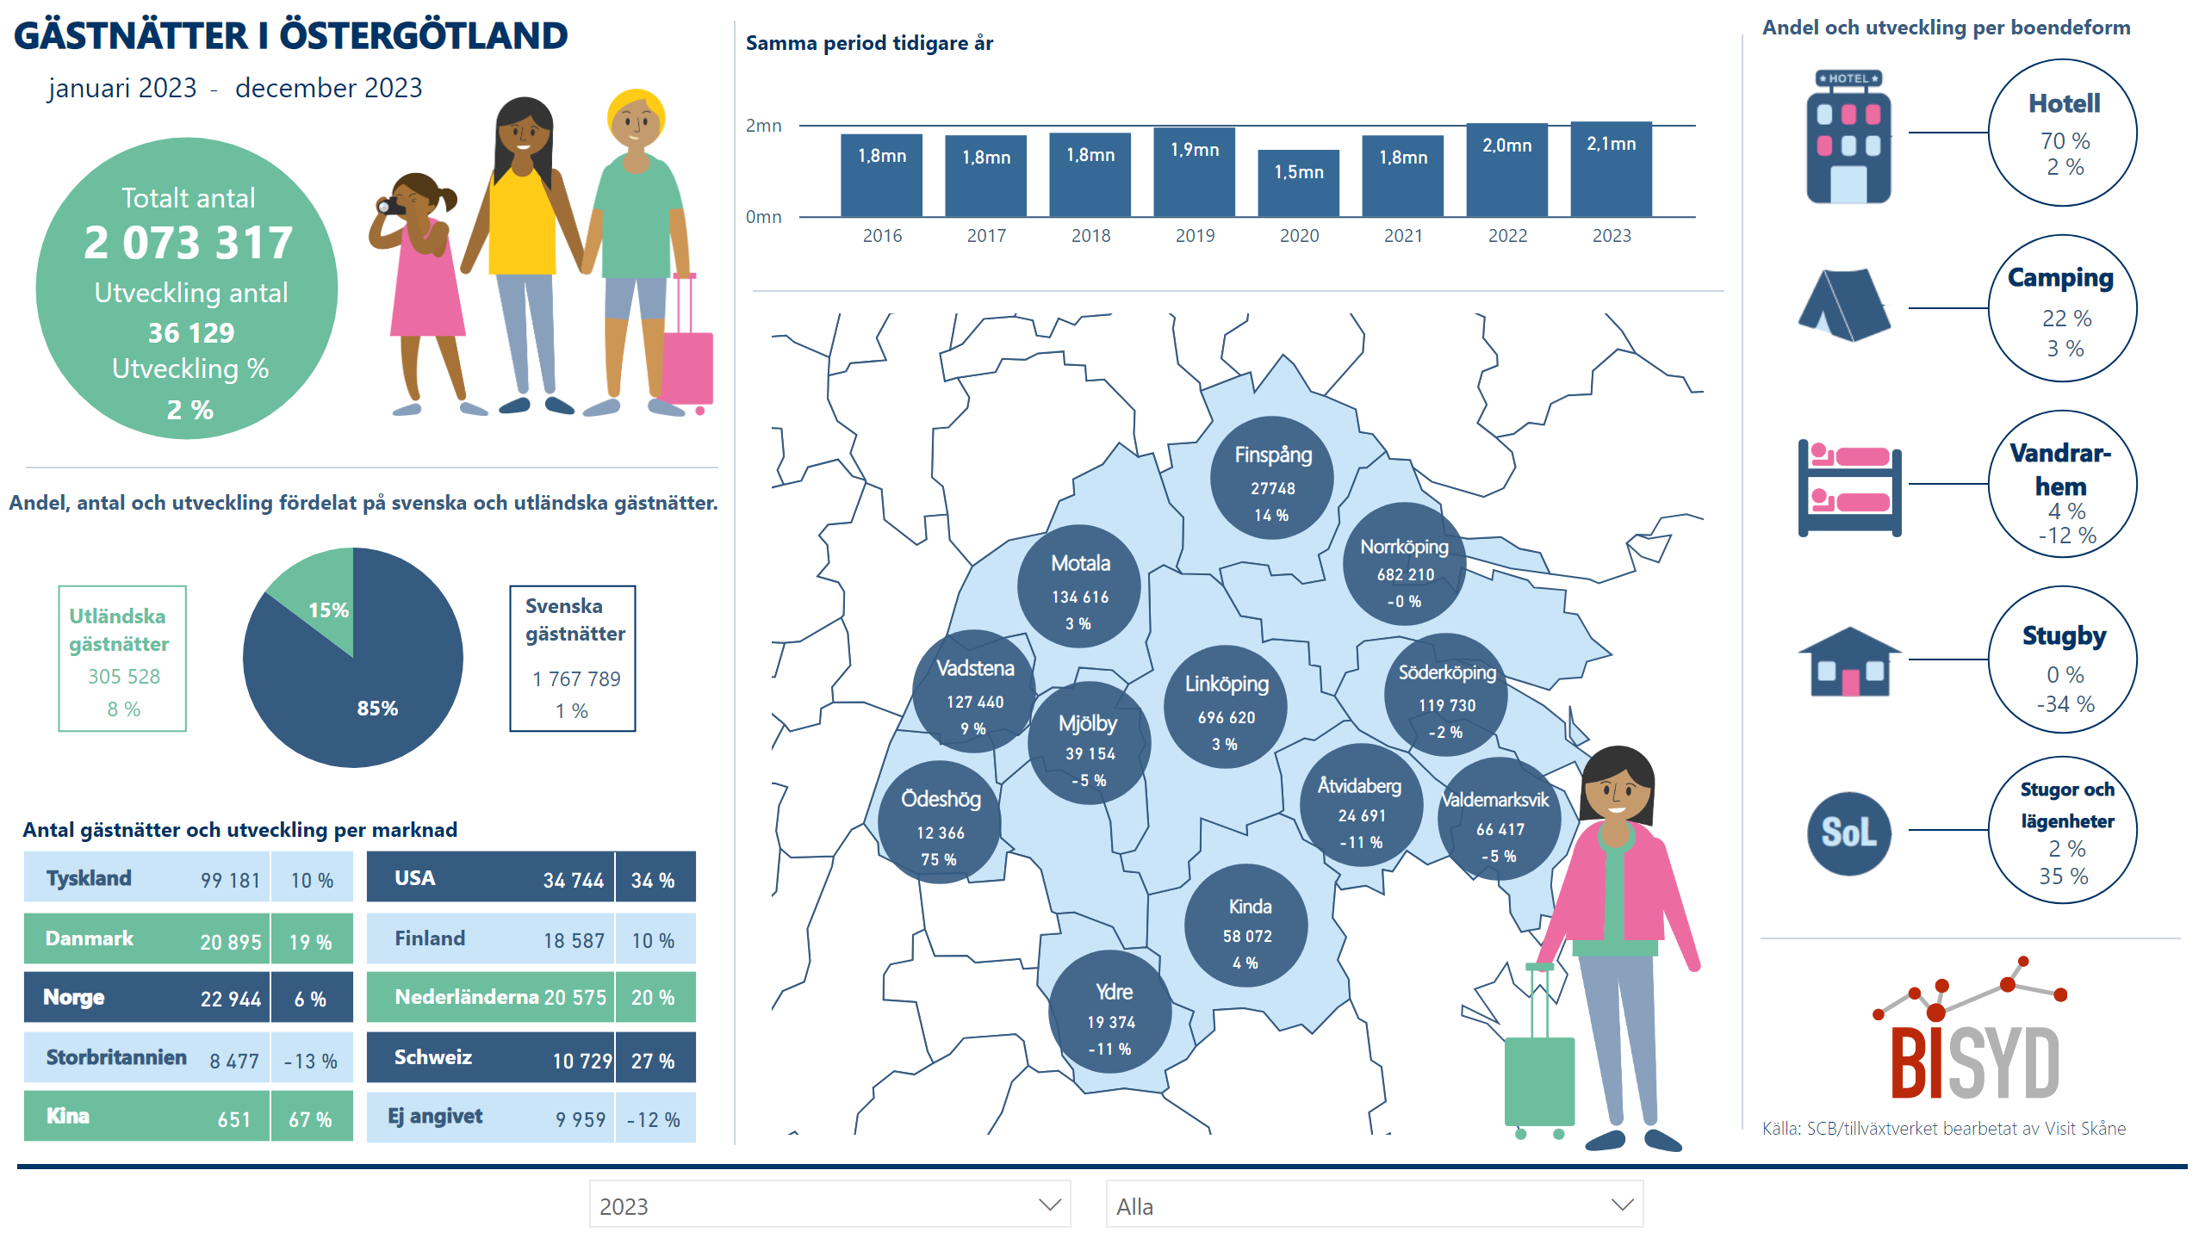
Östergötland
Notes:
slicer
No alt text provided
textbox
No alt text provided
card
No alt text provided
basicShape
No alt text provided
basicShape
No alt text provided
card
No alt text provided
basicShape
No alt text provided
textbox
No alt text provided
card
No alt text provided
card
No alt text provided
basicShape
No alt text provided
basicShape
No alt text provided
textbox
No alt text provided
card
No alt text provided
card
No alt text provided
basicShape
No alt text provided
basicShape
No alt text provided
textbox
No alt text provided
card
No alt text provided
card
No alt text provided
basicShape
No alt text provided
basicShape
No alt text provided
textbox
No alt text provided
card
No alt text provided
card
No alt text provided
basicShape
No alt text provided
basicShape
No alt text provided
image
No alt text provided
image
No alt text provided
image
No alt text provided
image
No alt text provided
Fördelning på svenska och utländska gästnätter
No alt text provided
Svenska gästnätter
No alt text provided
Utv % svenska gästnätter
No alt text provided
basicShape
No alt text provided
basicShape
No alt text provided
basicShape
No alt text provided
Totalt antal
No alt text provided
Utveckling %
No alt text provided
Utveckling antal
No alt text provided
image
No alt text provided
slicer
No alt text provided
card
No alt text provided
textbox
No alt text provided
card
No alt text provided
textbox
No alt text provided
textbox
No alt text provided
Samma period tidigare år
No alt text provided
basicShape
No alt text provided
textbox
No alt text provided
card
No alt text provided
card
No alt text provided
basicShape
No alt text provided
textbox
No alt text provided
card
No alt text provided
card
No alt text provided
basicShape
No alt text provided
textbox
No alt text provided
card
No alt text provided
card
No alt text provided
basicShape
No alt text provided
basicShape
No alt text provided
textbox
No alt text provided
card
No alt text provided
card
No alt text provided
basicShape
No alt text provided
textbox
No alt text provided
card
No alt text provided
card
No alt text provided
basicShape
No alt text provided
textbox
No alt text provided
card
No alt text provided
basicShape
No alt text provided
textbox
No alt text provided
card
No alt text provided
card
No alt text provided
basicShape
No alt text provided
textbox
No alt text provided
card
No alt text provided
card
No alt text provided
basicShape
No alt text provided
textbox
No alt text provided
card
No alt text provided
card
No alt text provided
basicShape
No alt text provided
textbox
No alt text provided
card
No alt text provided
card
No alt text provided
card
No alt text provided
basicShape
No alt text provided
image
No alt text provided
Utveckling per kommun mot föregående år
No alt text provided
Utländska gästnätter
No alt text provided
Utv % utländska gästnätter
No alt text provided
basicShape
No alt text provided
basicShape
No alt text provided
image
No alt text provided
basicShape
No alt text provided
image
No alt text provided
textbox
No alt text provided
card
No alt text provided
card
No alt text provided
basicShape
No alt text provided
textbox
No alt text provided
card
No alt text provided
card
No alt text provided
basicShape
No alt text provided
textbox
No alt text provided
card
No alt text provided
card
No alt text provided
basicShape
No alt text provided
textbox
No alt text provided
card
No alt text provided
card
No alt text provided
basicShape
No alt text provided
textbox
No alt text provided
card
No alt text provided
card
No alt text provided
basicShape
No alt text provided
textbox
No alt text provided
card
No alt text provided
card
No alt text provided
basicShape
No alt text provided
textbox
No alt text provided
card
No alt text provided
card
No alt text provided
basicShape
No alt text provided
textbox
No alt text provided
card
No alt text provided
card
No alt text provided
basicShape
No alt text provided
textbox
No alt text provided
card
No alt text provided
card
No alt text provided
basicShape
No alt text provided
textbox
No alt text provided
card
No alt text provided
card
No alt text provided
basicShape
No alt text provided
textbox
No alt text provided
textbox
No alt text provided
card
No alt text provided
card
No alt text provided
basicShape
No alt text provided
textbox
No alt text provided
card
No alt text provided
card
No alt text provided
basicShape
No alt text provided
textbox
No alt text provided
textbox
No alt text provided
shape
No alt text provided
shape
No alt text provided

